Slide 1
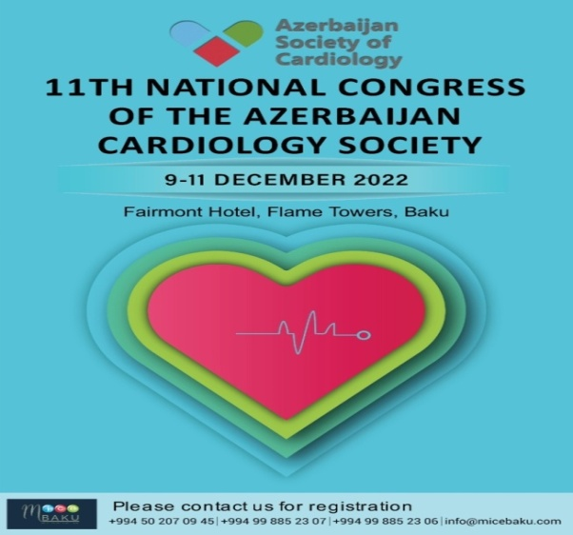
Updated recommendations for the diagnosis and treatment of cardiac amyloidosis
Yusupova А.О.
Professor, MD, PhD
The Department of Hospital Therapy # 1
Sechenov University

Slide 2
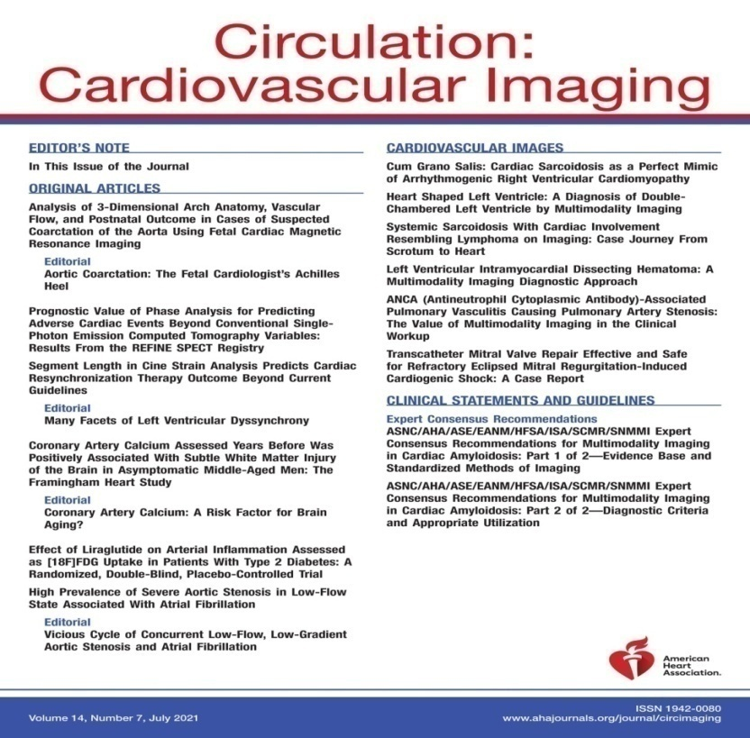
Expert Consensus Recommendations for the Suspicion and Diagnosis of Cardiac ATTR Amyloidosis. 2019
ASNC/AHA/ASE/EANM/HFSA/ISA/SCMR/SNMMI Expert Consensus Recommendations for Multimodality Imaging in Cardiac Amyloidosis. 2021

Slide 3
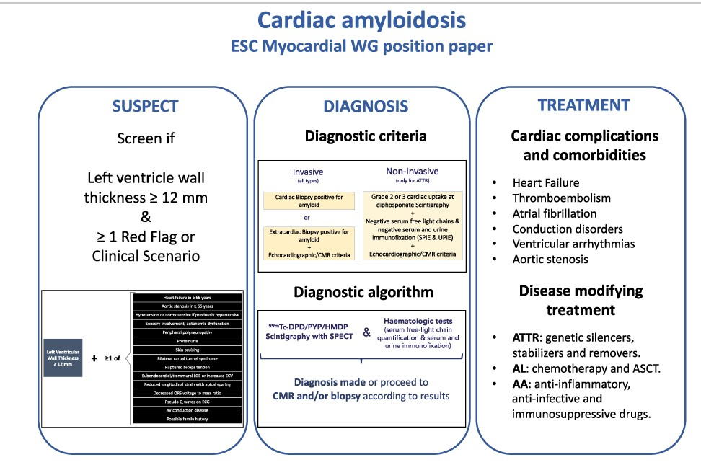
Diagnosis and treatment of cardiac amyloidosis: a position statement of the ESC Working Group on Myocardial and Pericardial Diseases, 2021.
European J of Heart Fail, Volume: 23, Issue: 4, Pages: 512-526, First published: 07 April 2021, DOI: (10.1002/ejhf.2140)

Slide 4
Amyloidosis subtypes that affect the heart
Amyloidosis type | Protein | Hereditary | Frequency of heart involvement | Median survival from diagnosis (months) | Usual extracardiac signs
AL | Immunoglobulin light chain | No | 70% | 24 6 (if HF at diagnosis and not treated) | Nephropathy, proteinuria, autonomic dysfunction, polyneuropathy, macroglossia, spontaneous bruising, liver involvement
ATTRwt | Transthyretin | No | 100% | 57 | CTS, LSS, ruptured biceps tendon
ATTRv | Transthyretin | Yes | 30–100% Depending on the mutation | 31 (Val142Ile) 69 (non-Val142Ile) | Polyneuropathy, orthostatic hypotension, vitreous opacities, gastrointestinal problems
AA | Serum amyloid A | No | 5% | 133 | Renal impairment (95%), proteinuria, hepatomegaly, gastrointestinal problems
AFib | Fibrinogen α | Yes | Rare | 180 | Renal impairment, proteinuria
European J of Heart Fail, Volume: 23, Issue: 4, Pages: 512-526, First published: 07 April 2021, DOI: (10.1002/ejhf.2140)

Slide 5
Amyloidosis subtypes that affect the heart
Amyloidosis type | Protein | Hereditary | Frequency of heart involvement | Median survival from diagnosis (months) | Usual extracardiac signs
AApoAI | Apolipoprotein A-I | Yes | Rare Depending on the mutation | No data. Probably >120 | Primarily renal impairment, proteinuria, hepatosplenomegaly, adrenal insufficiency, dysphonia due to laryngeal involvement
AApoAII | Apolipoprotein A-II | Yes | Rare Depending on the mutation | No data | Primarily renal impairment, proteinuria
AApoAIV | Apolipoprotein A-IV | No | Unknown | 79 | Primarily renal impairment
Aβ2M | β2-microglobulin | No | 80% | No data | Long-term dialysis, CTS, joint problems
AGel | Gelsolin | Yes | 5% Primarily conduction disease | Near normal life expectancy | Corneal lattice dystrophy, cutis laxa, drooping eyelids, paresthaesia, proteinuria (rare)
European J of Heart Fail, Volume: 23, Issue: 4, Pages: 512-526, First published: 07 April 2021, DOI: (10.1002/ejhf.2140)

Slide 6
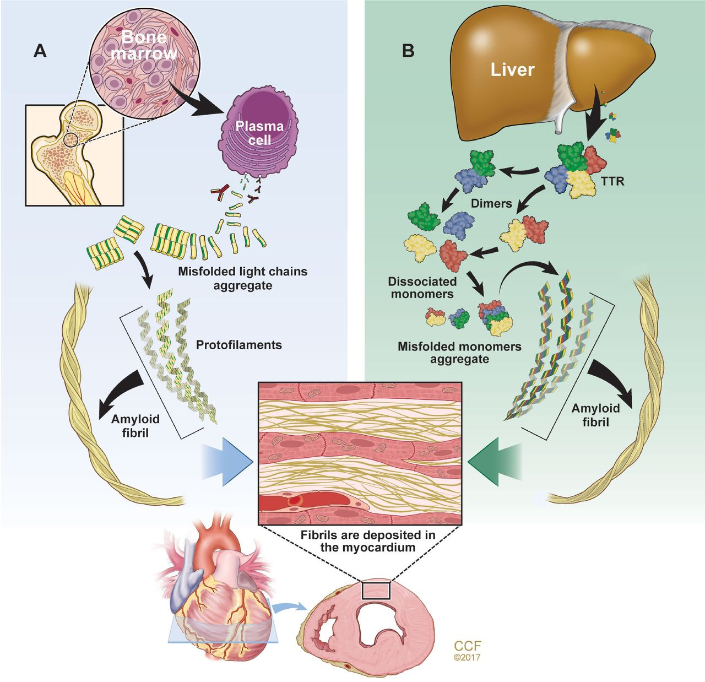
The 2 main types of cardiac amyloidosis
Immunoglobulin light chain amyloidosis (AL) results from aberrant plasma cell production of monoclonal light chains that misfold.
Transthyretin amyloidosis (ATTR) results from transthyretin (TTR) produced by the liver that dissociates into monomers and misfolds.
Cardiac amyloidosis: An update on diagnosis and treatment. Joseph P. Donnelly, MD and Mazen Hanna, MD.
Cleveland Clinic Journal of Medicine December 2017, 84 (12 suppl 3) 12-26; DOI: https://doi.org/10.3949/ccjm.84.s3.02

Slide 7
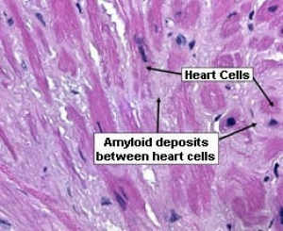
Endomyocardial biopsy (hematoxylin and eosin stain)
revealing the classic pale-pink appearance of amyloid deposits
surrounding each cardiomyocyte
(source: Stanford Amyloid Center).
European J of Heart Fail, Volume: 23, Issue: 4, Pages: 512-526, First published: 07 April 2021, DOI: (10.1002/ejhf.2140)
Notes:
Invasive and non‐invasive diagnosis of cardiac amyloidosis. ATTR, transthyretin amyloidosis; CMR, cardiac magnetic resonance; SPIE, serum protein electrophoresis with immunofixation; UPIE, urine protein electrophoresis with immunofixation.
IF THIS IMAGE HAS BEEN PROVIDED BY OR IS OWNED BY A THIRD PARTY, AS INDICATED IN THE CAPTION LINE, THEN FURTHER PERMISSION MAY BE NEEDED BEFORE ANY FURTHER USE. PLEASE CONTACT WILEY'S PERMISSIONS DEPARTMENT ON PERMISSIONS@WILEY.COM OR USE THE RIGHTSLINK SERVICE BY CLICKING ON THE 'REQUEST PERMISSIONS' LINK ACCOMPANYING THIS ARTICLE. WILEY OR AUTHOR OWNED IMAGES MAY BE USED FOR NON-COMMERCIAL PURPOSES, SUBJECT TO PROPER CITATION OF THE ARTICLE, AUTHOR, AND PUBLISHER.

Slide 8
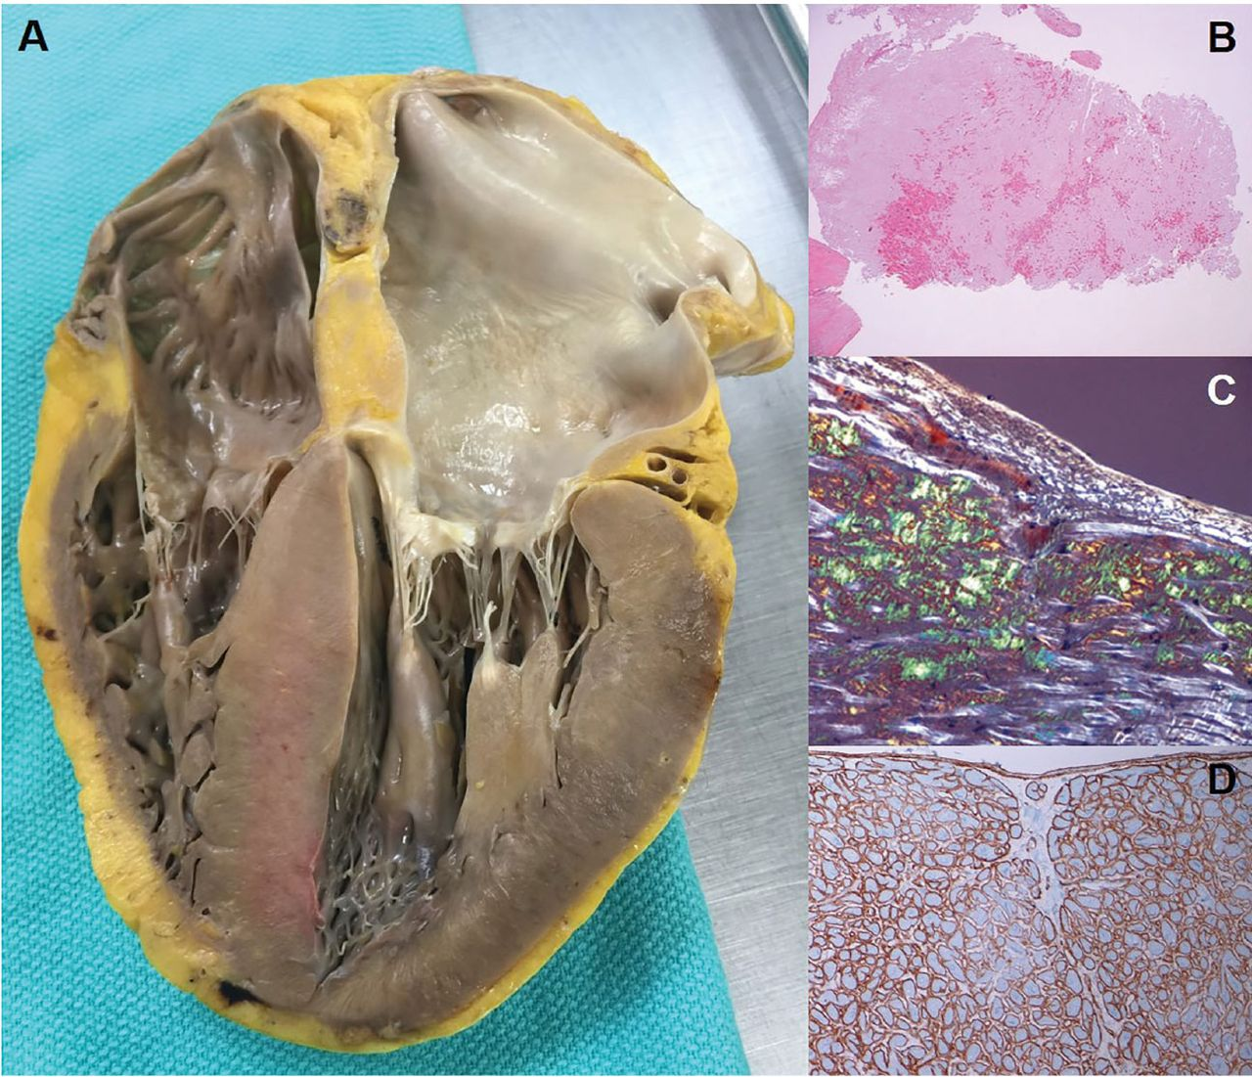
Cardiac amyloidosis pathology
A) The heart on autopsy:
biventricular thickening
biatrial dilation
thickening of both atrioventricular valves.
B) Hemotoxylin and eosin staining shows diffuse amyloid deposition.
C) The characteristic “apple-green” birefringence of Congo red stain under polarized light.
D) Immunohistochemistry :
positive for lambda light chain
negative for kappa light chain and transthyretin.
Copyright © 2017 The Cleveland Clinic Foundation. All Rights Reserved.
Joseph P. Donnelly, and Mazen Hanna CCJM 2017;84:12-26
Notes:
Cardiac amyloidosis pathology. (A) The heart on autopsy reveals characteristic biventricular thickening as well as biatrial dilation and thickening of both atrioventricular valves. (B) Hemotoxylin and eosin staining shows diffuse amyloid deposition. (C) The characteristic “apple-green” birefringence of Congo red stain under polarized light. (D) Example of immunohistochemistry performed for amyloid typing, in this case positive for lambda light chain and negative for kappa light chain and transthyretin.

Slide 9
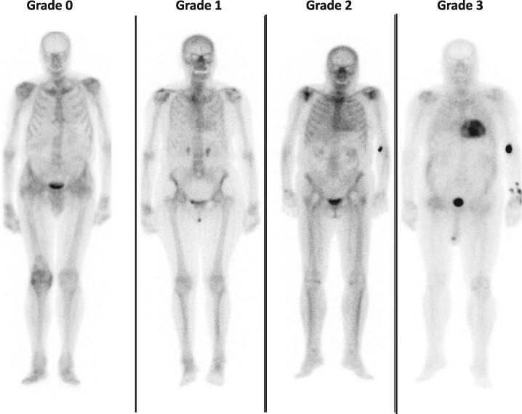
Cardiac uptake grading in bisphosphonate scintigraphy
Grade 0: absence of tracer myocardial uptake and normal bone uptake
Grade 1: myocardial uptake in a lower degree than at bone level
Grade 2:
similar myocardial
and bone uptake
Grade 3: myocardial uptake greater than bone with reduced/absent bone uptake.
European J of Heart Fail, Volume: 23, Issue: 4, Pages: 512-526, First published: 07 April 2021, DOI: (10.1002/ejhf.2140)

Slide 10
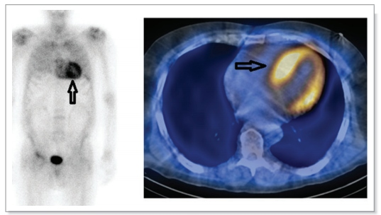
Cardiac uptake grading in bisphosphonate scintigraphy
A DPD scan showing TTR cardiac amyloid. The arrow points to the uptake of DPD in the heart.
Grade 3: myocardial uptake greater than bone with reduced/absent bone uptake.
Updates in Cardiac Amyloidosis: A Review; Banypersad S et al; J Am Heart Assoc 2012)
European J of Heart Fail, Volume: 23, Issue: 4, Pages: 512-526, First published: 07 April 2021, DOI: (10.1002/ejhf.2140)

Slide 11
Serum and urine tests to rule out light-chain amyloidosis
Tests | What does it detect? | Most sensitive test for: | Normal range
SPIE | Clonal immunoglobulin and/or clonal light chain | Confirming clonal immunoglobulin production | No monoclonal protein present
UPIE | Clonal immunoglobulin and/or clonal light chain | Confirming clonal light chain production | No monoclonal protein present
Serum free light-chain assay | Ratio of serum kappa: lambda light chains | Detecting low-level clonal light chain production; clonality assumed if ratio is far from 1:1 | Freelite: 0.26–1.65^{b} N Latex: 0.53–1.51
SPIE, serum protein electrophoresis with immunofixation;
UPIE, urine protein electrophoresis with immunofixation.
European J of Heart Fail, Volume: 23, Issue: 4, Pages: 512-526,
First published: 07 April 2021, DOI: (10.1002/ejhf.2140)

Slide 12
Echocardiographic and cardiac magnetic resonance criteria for non-invasive and invasive (with extracardiac biopsy-proven amyloidosis) diagnosis of cardiac amyloidosis (I)
Unexplained LV thickness (≥12 mm) plus 1 or 2:
1. Characteristic echocardiography findings (≥ 2 of a, b, and c have to be present):
a) Grade 2 or worse diastolic dysfunction
b) Reduced tissue Doppler sʹ, eʹ, and aʹ waves velocities (<5 cm/s)
c) Decreased global longitudinal LV strain (absolute value < −15%).
2. Multiparametric echocardiographic score ≥8 points:
a) Relative LV wall thickness (IVS+PWT)/LVEDD >0.6
3 points
b) Doppler E wave/eʹ wave velocities >11
1 point
c) TAPSE ≤ 19 mm
2 points
d) LV global longitudinal strain absolute value ≤ −13%
1 point
e) Systolic longitudinal strain apex to base ratio > 2.9
3 points
ECV, extracellular volume;
IVS, interventricular septum;
LGE, late gadolinium enhancement;
LV, left ventricular;
LVEDD, left ventricular end-diastolic diameter;
PWT, posterior wall thickness;
TAPSE, tricuspid annular plane systolic excursion.
European J of Heart Fail, Volume: 23, Issue: 4, Pages: 512-526, First published: 07 April 2021, DOI: (10.1002/ejhf.2140)

Slide 13
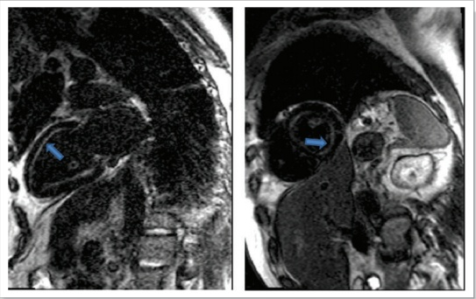
Echocardiographic and cardiac magnetic resonance criteria for non-invasive and invasive (with extracardiac biopsy-proven amyloidosis) diagnosis of cardiac amyloidosis (II)
Characteristic CMR findings
(a and b have to be present):
a) Diffuse subendocardial or transmural LGE
b) Abnormal gadolinium kinetics
c) ECV ≥0.40% (strongly supportive,
but not essential/diagnostic)
ECV, extracellular volume;
IVS, interventricular septum;
LGE, late gadolinium enhancement;
LV, left ventricular;
LVEDD, left ventricular end-diastolic diameter;
PWT, posterior wall thickness;
TAPSE, tricuspid annular plane systolic excursion.
Updates in Cardiac Amyloidosis: A Review; Banypersad S et al; J Am Heart Assoc 2012.
European J of Heart Fail, Volume: 23, Issue: 4, Pages: 512-526, First published: 07 April 2021, DOI: (10.1002/ejhf.2140)

Slide 14
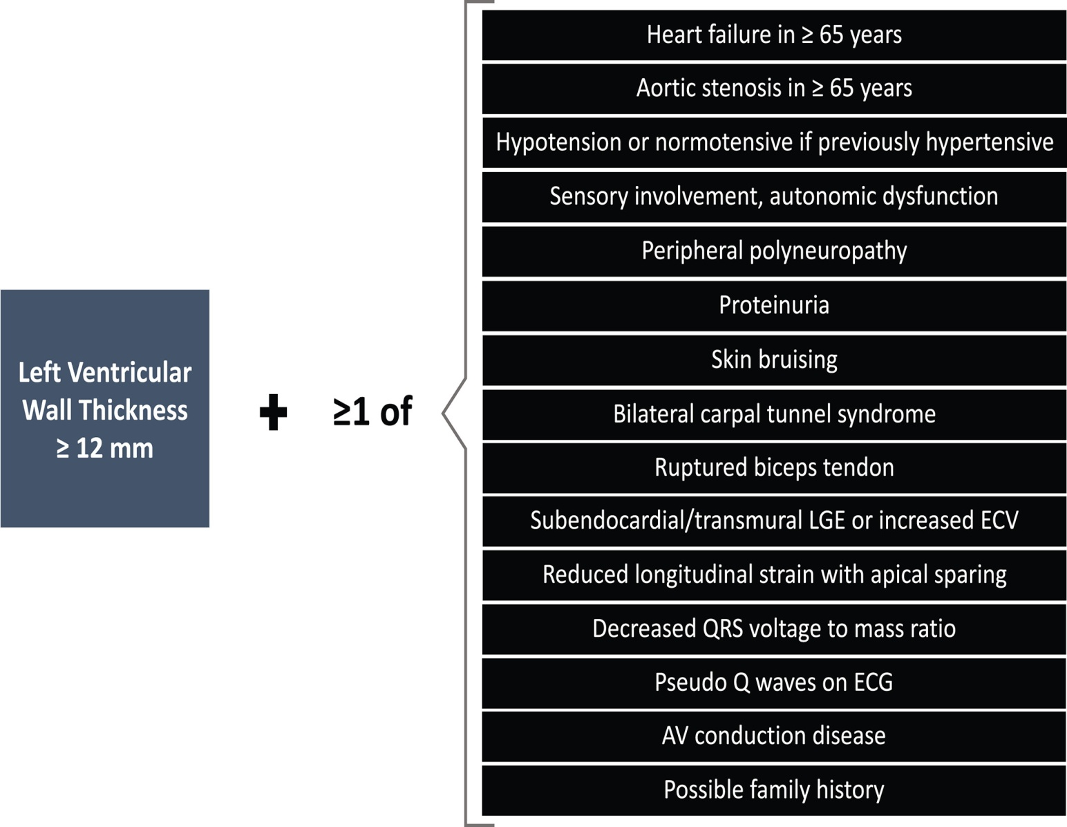
Screening for cardiac amyloidosis.
European J of Heart Fail, Volume: 23, Issue: 4, Pages: 512-526, First published: 07 April 2021, DOI: (10.1002/ejhf.2140)
Notes:
Screening for cardiac amyloidosis. AV, atrio‐ventricular; ECG, electrocardiogram; ECV, extracellular volume; LGE, late gadolinium enhancement.
IF THIS IMAGE HAS BEEN PROVIDED BY OR IS OWNED BY A THIRD PARTY, AS INDICATED IN THE CAPTION LINE, THEN FURTHER PERMISSION MAY BE NEEDED BEFORE ANY FURTHER USE. PLEASE CONTACT WILEY'S PERMISSIONS DEPARTMENT ON PERMISSIONS@WILEY.COM OR USE THE RIGHTSLINK SERVICE BY CLICKING ON THE 'REQUEST PERMISSIONS' LINK ACCOMPANYING THIS ARTICLE. WILEY OR AUTHOR OWNED IMAGES MAY BE USED FOR NON-COMMERCIAL PURPOSES, SUBJECT TO PROPER CITATION OF THE ARTICLE, AUTHOR, AND PUBLISHER.

Slide 15
Cardiac and extracardiac amyloidosis red flags
Type | Red flag | Amyloidosis where it is most frequently found
Extracardiac
Clinical | Polyneuropathy | ATTRv, AL, AA, AGel
 | Dysautonomia | ATTR, AL
 | Skin bruising | AL
 | Skin discoloration | AApoAI
 | Cutis laxa | AGel
 | Macroglossia | AL
 | Deafness | ATTRwt
 | Bilateral carpal tunnel syndrome | ATTRv, ATTRwt
 | Ruptured biceps tendon | ATTRwt
 | Lumbar spinal stenosis | ATTRwt
 | Vitreous deposits | ATTRv
 | Corneal lattice dystrophy | AGel
 | Family history | ATTRv, AApoAI, AApoAII
Laboratory | Renal insufficiency | AL, AA, AApoAI, AApoAII, AApoAIV, Aβ2M, AFib
 | Proteinuria | AL, AA, AApoAI, AApoAII, AFib
European J of Heart Fail, Volume: 23, Issue: 4, Pages: 512-526, First published: 07 April 2021, DOI: (10.1002/ejhf.2140)

Slide 16
Cardiac and extracardiac amyloidosis red flags
Cardiac | Red flag
Clinical | Hypotension or normotensive if previous hypertensive | ATTR, AL
ECG | Pseudoinfarct pattern | All
 | Low/decreased QRS voltage to degree of LV thickness | All
 | AV conduction disease | All
Laboratory | Disproportionally elevated NT-proBNP to degree of HF | All
 | Persisting elevated troponin levels | ATTR, AL
Echocardiogram | Granular sparkling of myocardium | All
 | Increased right ventricular wall thickness | All
 | Increased valve thickness | All
 | Pericardial effusion | All
 | Reduced longitudinal strain with apical sparing pattern | All
CMR | Subendocardial late gadolinium enhancement | All
 | Elevated native T1 values | All
 | Increased extracellular volume | All
 | Abnormal gadolinium kinetics | All
European J of Heart Fail, Volume: 23, Issue: 4, Pages: 512-526, First published: 07 April 2021, DOI: (10.1002/ejhf.2140)

Slide 17
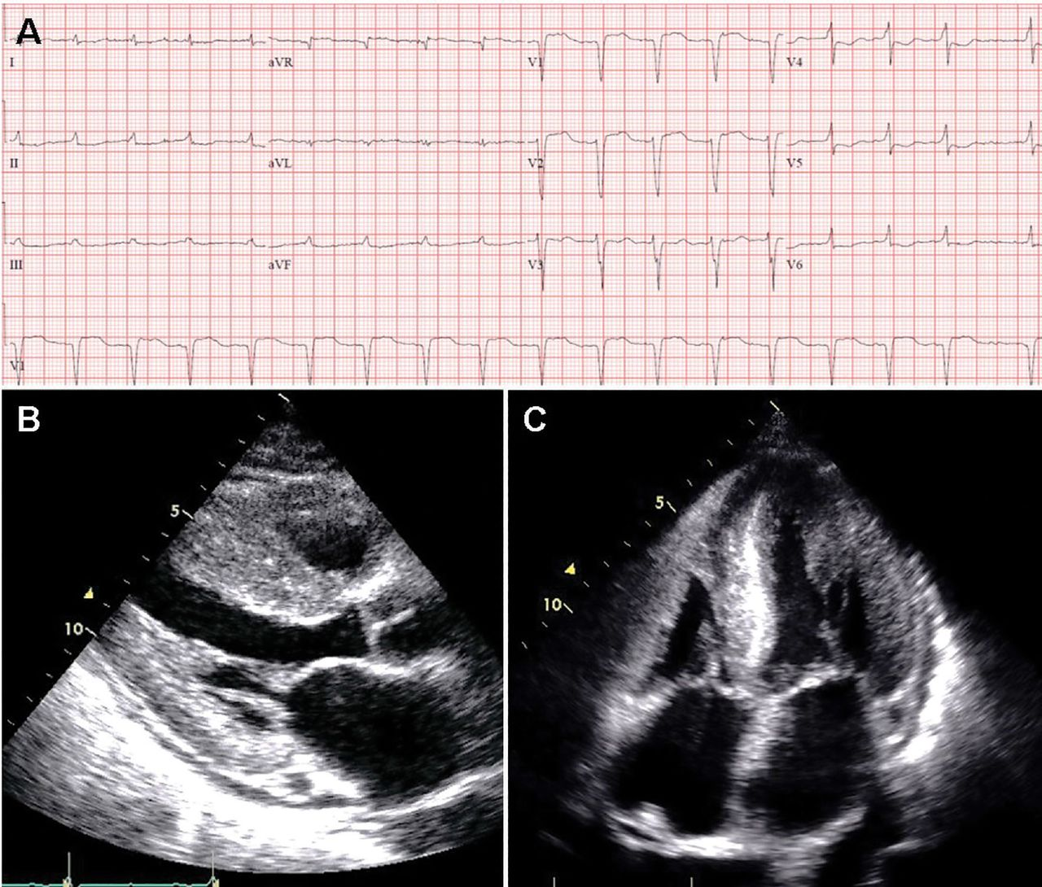
Cardiac and extracardiac amyloidosis red flags
Cardiac | Red flag
Clinical | Hypotension or normotensive if previous hypertensive | ATTR, AL
ECG | Pseudoinfarct pattern | All
 | Low/decreased QRS voltage to degree of LV thickness | All
 | AV conduction disease | All
Laboratory | Disproportionally elevated NT-proBNP to degree of HF | All
 | Persisting elevated troponin levels | ATTR, AL
Echocardiogram | Granular sparkling of myocardium | All
 | Increased right ventricular wall thickness | All
 | Increased valve thickness | All
 | Pericardial effusion | All
 | Reduced longitudinal strain with apical sparing pattern | All
CMR | Subendocardial late gadolinium enhancement | All
 | Elevated native T1 values | All
 | Increased extracellular volume | All
 | Abnormal gadolinium kinetics | All
Joseph P. Donnelly, and Mazen Hanna CCJM 2017;84:12-26
European J of Heart Fail, Volume: 23, Issue: 4, Pages: 512-526, First published: 07 April 2021, DOI: (10.1002/ejhf.2140)

Slide 18
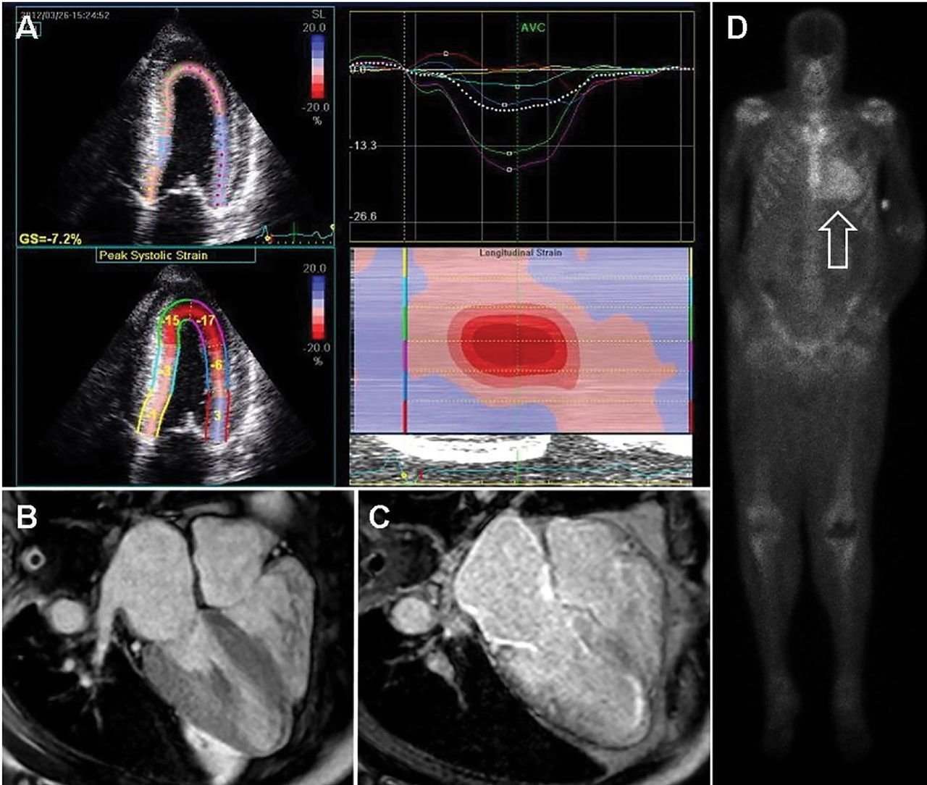
Cardiac and extracardiac amyloidosis red flags
Cardiac | Red flag
Clinical | Hypotension or normotensive if previous hypertensive | ATTR, AL
ECG | Pseudoinfarct pattern | All
 | Low/decreased QRS voltage to degree of LV thickness | All
 | AV conduction disease | All
Laboratory | Disproportionally elevated NT-proBNP to degree of HF | All
 | Persisting elevated troponin levels | ATTR, AL
Echocardiogram | Granular sparkling of myocardium | All
 | Increased right ventricular wall thickness | All
 | Increased valve thickness | All
 | Pericardial effusion | All
 | Reduced longitudinal strain with apical sparing pattern | All
CMR | Subendocardial late gadolinium enhancement | All
 | Elevated native T1 values | All
 | Increased extracellular volume | All
 | Abnormal gadolinium kinetics | All
Joseph P. Donnelly, and Mazen Hanna CCJM 2017;84:12-26
European J of Heart Fail, Volume: 23, Issue: 4, Pages: 512-526, First published: 07 April 2021, DOI: (10.1002/ejhf.2140)

Slide 19
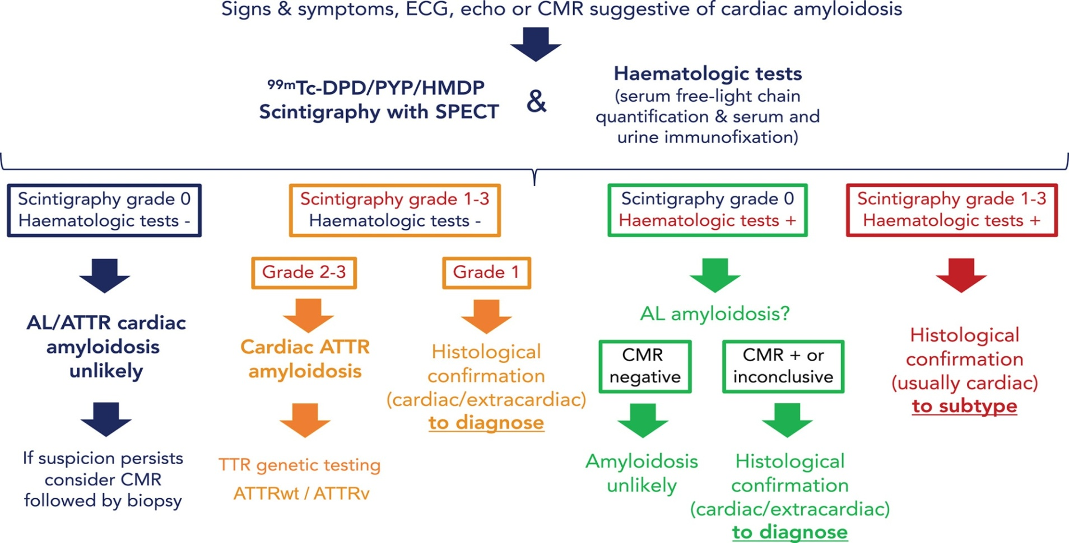
Diagnostic algorithm for cardiac amyloidosis
European J of Heart Fail, Volume: 23, Issue: 4, Pages: 512-526, First published: 07 April 2021, DOI: (10.1002/ejhf.2140)
Notes:
Diagnostic algorithm for cardiac amyloidosis. ATTR, transthyretin amyloidosis; ATTRv, hereditary transthyretin amyloidosis; ATTRwt, wild‐type transthyretin amyloidosis; AL, light‐chain amyloidosis; CMR, cardiac magnetic resonance; ECG, electrocardiogram; SPECT, single photon emission computed tomography; TTR, transthyretin.
IF THIS IMAGE HAS BEEN PROVIDED BY OR IS OWNED BY A THIRD PARTY, AS INDICATED IN THE CAPTION LINE, THEN FURTHER PERMISSION MAY BE NEEDED BEFORE ANY FURTHER USE. PLEASE CONTACT WILEY'S PERMISSIONS DEPARTMENT ON PERMISSIONS@WILEY.COM OR USE THE RIGHTSLINK SERVICE BY CLICKING ON THE 'REQUEST PERMISSIONS' LINK ACCOMPANYING THIS ARTICLE. WILEY OR AUTHOR OWNED IMAGES MAY BE USED FOR NON-COMMERCIAL PURPOSES, SUBJECT TO PROPER CITATION OF THE ARTICLE, AUTHOR, AND PUBLISHER.

Slide 20
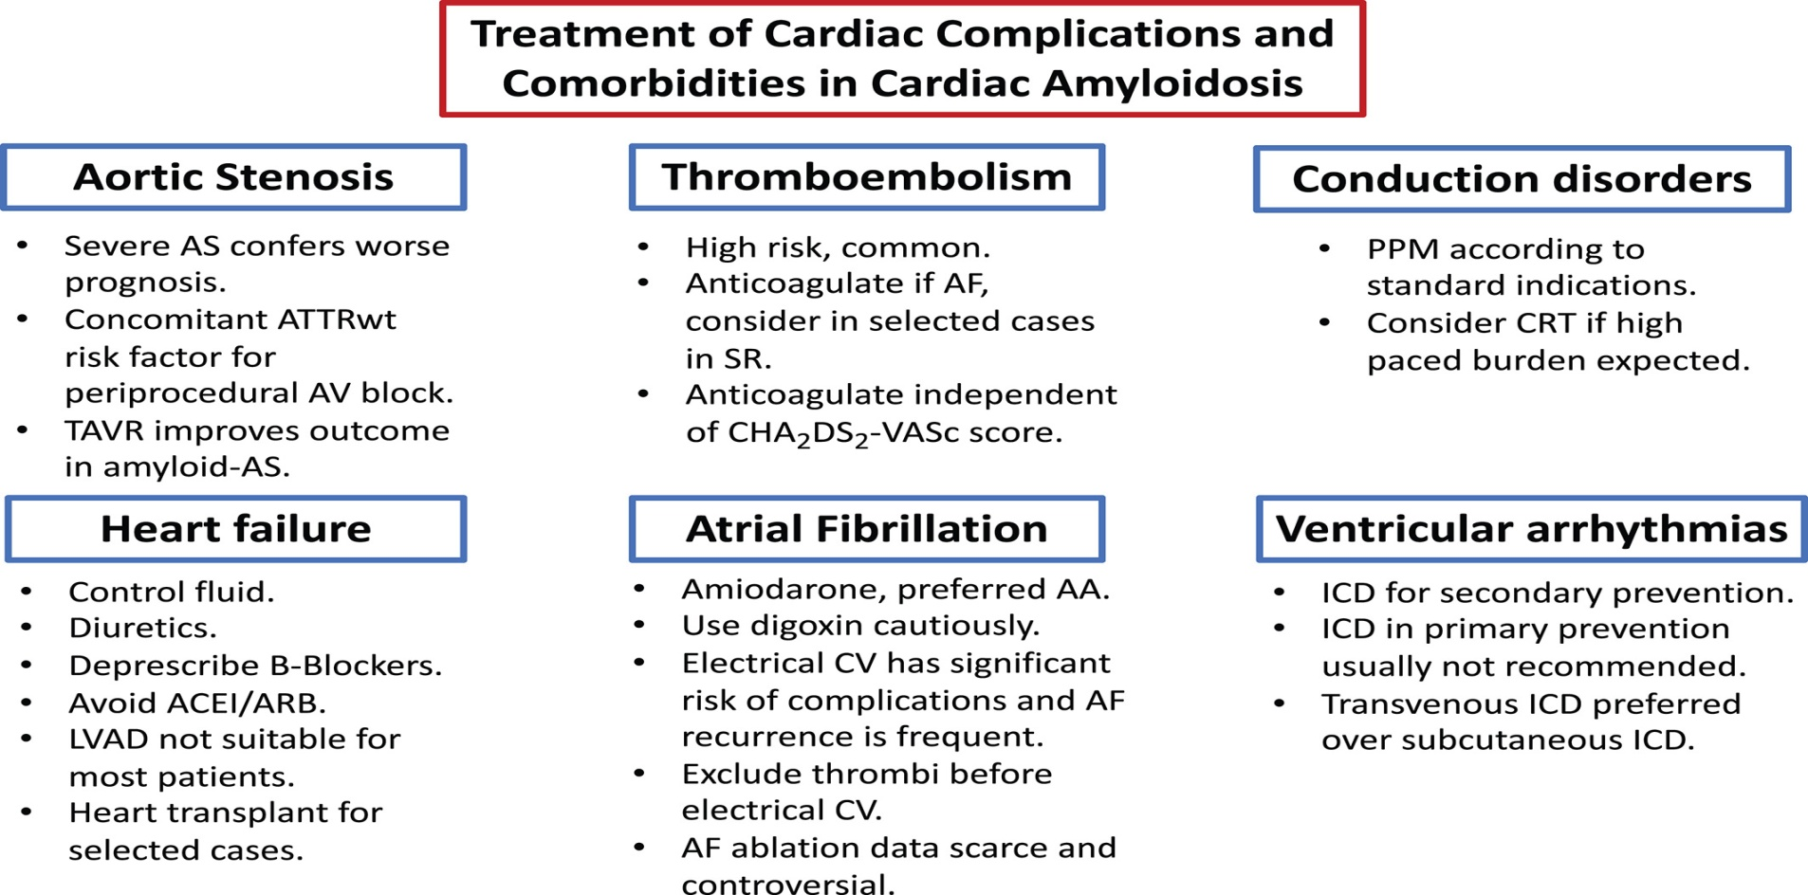
European J of Heart Fail, Volume: 23, Issue: 4, Pages: 512-526, First published: 07 April 2021, DOI: (10.1002/ejhf.2140)
Notes:
Treatment of cardiac complications and comorbidities in cardiac amyloidosis. AA, antiarrhythmic; ACEI, angiotensin‐converting enzyme inhibitor; AF, atrial fibrillation; ARB, angiotensin receptor blocker; AS, aortic stenosis; ATTRwt, wild‐type transthyretin amyloidosis; AV, atrio‐ventricular; CRT, cardiac resynchronization therapy; CV, cardioversion; ICD, implantable cardioverter‐defibrillator; LVAD, left ventricular assist device; PPM, permanent pacemaker; SR, sinus rhythm; TAVR, transcatheter aortic valve replacement.
IF THIS IMAGE HAS BEEN PROVIDED BY OR IS OWNED BY A THIRD PARTY, AS INDICATED IN THE CAPTION LINE, THEN FURTHER PERMISSION MAY BE NEEDED BEFORE ANY FURTHER USE. PLEASE CONTACT WILEY'S PERMISSIONS DEPARTMENT ON PERMISSIONS@WILEY.COM OR USE THE RIGHTSLINK SERVICE BY CLICKING ON THE 'REQUEST PERMISSIONS' LINK ACCOMPANYING THIS ARTICLE. WILEY OR AUTHOR OWNED IMAGES MAY BE USED FOR NON-COMMERCIAL PURPOSES, SUBJECT TO PROPER CITATION OF THE ARTICLE, AUTHOR, AND PUBLISHER.

Slide 21
NCCN Guidelines Version 1/2022 Systemic Light Chain Amyloidosis. www.nccn.org
Notes:
Over the last decade, chemotherapy options for AL amyloidosis have markedly improved, such that most patients can achieve large reductions in (and sometimes complete normalization of) their circulating pathologic light chains. Chemotherapy typically involves the combination of multiple classes of antineoplastics, including alkylators (e.g., melphalan or cyclophosphamide), steroids (e.g., dexamethasone), proteasome inhibitors (e.g., bortezomib or carfilzomib), and/or immunomodulators (e.g., lenalidomide or pomalidomide). An alternative strategy involves auto-stem-cell transplant utilizing high-dose chemotherapy with an alkylating agent. Although auto-stem-cell transplant can be an effective method of lowering light chains and is used by many centers, the only randomized trial comparing it to standard chemotherapy found auto-stem-cell transplant to have inferior outcomes.¹⁴ Given the rapid improvements in standard chemotherapy options over the last decade, our center's practice is to pursue auto-stem-cell transplant only rarely in select cases.

Slide 22
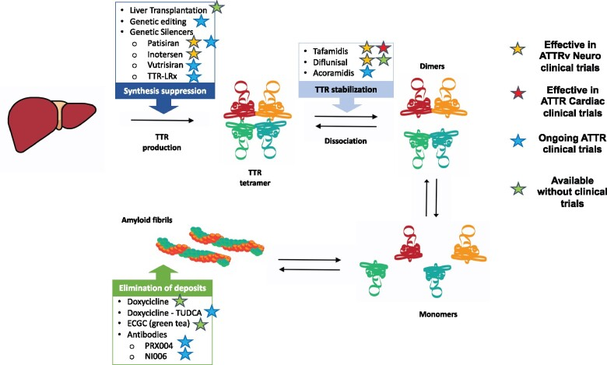
Available and future disease-modifying therapies in transthyretin amyloidosis
European J of Heart Fail, Volume: 23, Issue: 4, Pages: 512-526, First published: 07 April 2021, DOI: (10.1002/ejhf.2140)

Slide 23
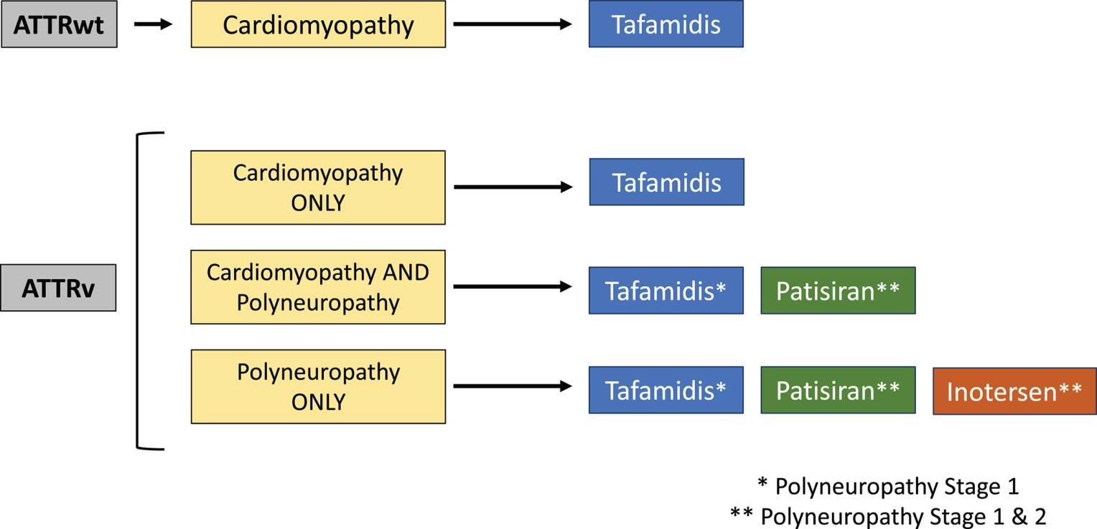
Available disease-modifying therapies in transthyretin amyloidosis
Transthyretin tetramer
stabilizers
Transthyretin gene silencers
siRNA
Antisense
oligonucleotides
European J of Heart Fail, Volume: 23, Issue: 4, Pages: 512-526, First published: 07 April 2021, DOI: (10.1002/ejhf.2140)
Notes:
Proposed therapeutic alternatives in transthyretin amyloidosis patients. ATTRv, hereditary transthyretin amyloidosis; ATTRwt, wild‐type transthyretin amyloidosis.
IF THIS IMAGE HAS BEEN PROVIDED BY OR IS OWNED BY A THIRD PARTY, AS INDICATED IN THE CAPTION LINE, THEN FURTHER PERMISSION MAY BE NEEDED BEFORE ANY FURTHER USE. PLEASE CONTACT WILEY'S PERMISSIONS DEPARTMENT ON PERMISSIONS@WILEY.COM OR USE THE RIGHTSLINK SERVICE BY CLICKING ON THE 'REQUEST PERMISSIONS' LINK ACCOMPANYING THIS ARTICLE. WILEY OR AUTHOR OWNED IMAGES MAY BE USED FOR NON-COMMERCIAL PURPOSES, SUBJECT TO PROPER CITATION OF THE ARTICLE, AUTHOR, AND PUBLISHER.

Slide 24
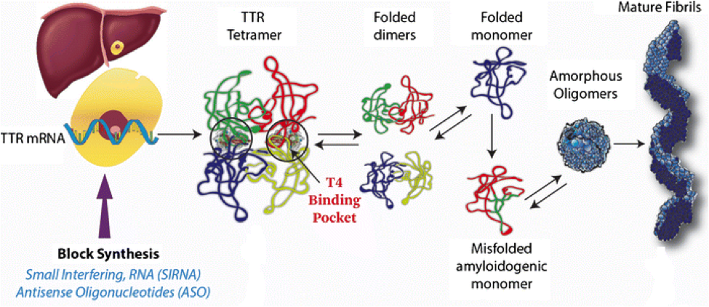
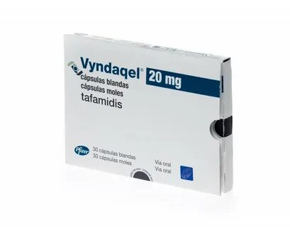
Available disease-modifying therapies in transthyretin amyloidosis. Transthyretin tetramer stabilizers. Tafamidis.
interacts with TTR’s thyroxine binding pocket and increases tetrameric stability
Tafamis is an oral transthyretin stabilizer FDA approved for treatment of adults with transthyretin-mediated amyloid cardiomyopathy (ATTR-CM).
it has been shown to decrease the number of hospitalizations and deaths in patients with ATTR-CM.
is available in two formulations: tafamidis meglumine (20 mg pills), in which the FDA recommended daily dose is 80 mg a day; or tafamidis free salt (61 mg a day).
https://newdrugapprovals.org/2018/08/13/patisiran/

Slide 25
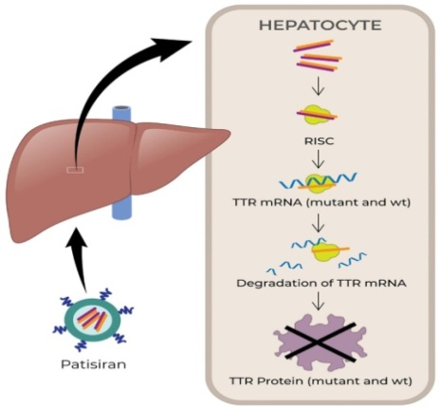
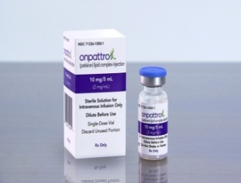
Available disease-modifying therapies in transthyretin amyloidosis. Transthyretin gene silencers. Patisiran & Inotersen.
specifically inhibits hepatic synthesis of transthyretin.
TTR silencing therapy with patisiran or inotersen may be considered in patients with ATTRv and polyneuropathy; the choice between inotersen and patisiran is based on availability and adverse effect profiles.
these drugs are currently not indicated for ATTRv-cardiomyopathy without polyneuropathy or in patients with ATTRwt-cardiomyopathy.
patisiran significantly improved LV basal LS, lowered NT pro-BNP, and ameliorated abnormal LV geometric patterns including LVH
trials with oligonucleotide drugs (inotersen, patisiran) have shown improved multiple clinical manifestations of hereditary transthyretin amyloidosis.
Common Adverse Effects of Patisiran
upper respiratory tract infections, infusion-related reactions, dyspnea, muscle spasms, arthralgia, erythema, bronchitis, vertigo.
Common Adverse Effects of Inotersen
glomerulonephritis (3%) and life‐threatening thrombocytopaenia (3%).
Thus, frequent laboratory monitoring is necessary to avoid these potential side effects.
Both silencers (inotersen and patisiran) require supplementation of vitamin A (3000 U daily) because the silencing of TTR production can impair vitamin A delivery.
https://newdrugapprovals.org/2018/08/13/patisiran/

Slide 26
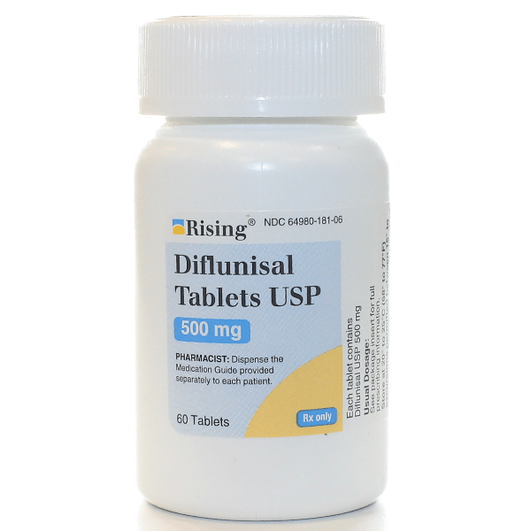
Transthyretin tetramer stabilizer. Diflunisal
a non‐steroidal anti‐inflammatory drug, can stabilize TTR tetramers in vitro.
significantly reduced the progression of neurologic impairment and preserved QOL, compared with placebo.
diflunisal had no beneficial effects on the improvement in cardiac status.
its cyclooxygenase inhibitory activity can cause renal and gastrointestinal damage, such as renal failure, gastric mucosal injury, volume overload, and hypertension.
may be considered for off-label use in patients with ATTR-CA with relatively preserved kidney function and no increased bleeding risk, taken under the supervision of a cardiologist who will monitor for fluid retention and changes in renal function
Transthyretin cardiac amyloidosis: an update on diagnosis and treatment. ESC Heart Fail. 2019 Dec; 6(6): 1128–1139.

Slide 27
Transthyretin amyloid disruptors
Doxycycline/tauroursodeoxycholic acid (TUDCA)
Both the tetracycline antibiotic doxycycline and the TUDCA are effective in degrading non‐fibrillar TTR deposits.
The concurrent treatment has been verified to attenuate disease progression in ATTR amyloidosis patients in limited clinical trials.
Cardiac Amyloidosis Therapy: A Systematic Review. Cardiogenetics 2021, 11(1), 10-17; https://doi.org/10.3390/cardiogenetics11010002

Slide 28
Summary
Although nine types of cardiac amyloidosis are known, AL and ATTR currently account for the vast majority of cardiac amyloidosis.
Both invasive and non-invasive diagnostic criteria are accepted to diagnose cardiac amyloidosis. While invasive diagnostic criteria apply to all forms of cardiac amyloidosis, non-invasive criteria are accepted only for ATTR.
Cardiac amyloidosis should be considered in patients with increased wall thickness in the presence of cardiac or extracardiac red flags and/or in specific clinical situations.
A diagnostic algorithm based initially on the use of bone scintigraphy coupled to assessment for monoclonal proteins allows appropriate diagnosis in patients with suggestive signs/symptoms.
Management of cardiac amyloidosis involves treatment and prevention of complications, and halting or delaying amyloid deposition by specific treatments.
Specific pharmacologic treatments available for ATTR amyloidosis include stabilizing molecules (tafamidis) and genetic silencers (patisiran and inotersen).
Tafamidis is currently the only drug that has shown efficacy in a randomized trial in patients with ATTRwt and ATTRv with cardiomyopathy, and should be considered in patients with reasonable expected survival.

Slide 29
Thank you for your attention!

Slide 30
Doxycycline is a tetracycline antibiotic with demonstrated effectiveness in disrupting mature amyloid fibrils in mouse models.83 Tauroursodeoxycholic acid is a bile acid with the ability to disrupt prefibrillar amyloid components. This combination has been studied in patients with ATTR-CA in 2 small open-label trials, with only 1 having results published. There was no progression in NT-proBNP or wall thickness in a cohort of 7 patients who completed 12 months of treatment.84 These data are nonrandomized and hypothesis-generating, as adequate studies would need to be performed to evaluate this hypothesis further. Because there are currently no FDA-approved therapies for ATTR, patients may be offered this combination fully informed that the data are limited. (Note: ursodiol is substituted for tauroursodeoxycholic acid, which is not available in the United States.

Slide 31
• Patients with AL amyloidosis should be evaluated for autologous hematopoietic stem cell transplantation (HSCT). Patients with good performance status, age under 70 and limited organ involvement are good candidates.
The goal of chemotherapy is to decrease the production of the amyloidogenic light chain with therapy directed at the clonal plasma cells.
•All agents used to treat multiple myeloma are effective against AL, including melphalan, and prednisone. Immunomodulatory compounds (IMiDs) such as thalidomide or lenalidomide, or proteasome inhibitors are also affected. Patients ineligible for autologous HSCT should receive chemotherapy with melphalan- or bortezomib-based regimens.Table E4 summarizes major treatment options for amyloidosis.

Slide 32
Expert Consensus Recommendations for the Suspicion and Diagnosis of Transthyretin Cardiac Amyloidosis
Mathew S. Maurer,
Sabahat Bokhari,
Thibaud Damy,
Sharmila Dorbala,
Brian M. Drachman,
Marianna Fontana,
Martha Grogan,
Arnt V. Kristen,
Isabelle Lousada,
Jose Nativi-Nicolau,
Candida Cristina Quarta,
Claudio Rapezzi,
Frederick L. Ruberg,
Ronald Witteles and
Giampaolo Merlini
Originally published4 Sep 2019https://doi.org/10.1161/CIRCHEARTFAILURE.119.006075Circulation: Heart Failure. 2019;12:e006075
ATTRm is considered rare and is transmitted in an autosomal-dominant manner and with variable penetrance. Certain variants typically result in CM, whereas others typically result in polyneuropathy (PN), although CM and PN manifestations may overlap (Figure 1). The prevalence of CM among persons with ATTRm is estimated at approximately 40,000 of the 50,000 persons with ATTRm globally,⁴ but this may be an underestimate.

Slide 33
The classic hallmark of cardiac amyloidosis
ECG
Echocardiogram
Joseph P. Donnelly, and Mazen Hanna CCJM 2017;84:12-26
Notes:
The classic hallmark of cardiac amyloidosis. (A) A 12-lead electrocardiogram showing atrial fibrillation, low voltage in the limb leads, and a pseudoinfarct pattern with Q waves in leads V1-V2. (B) Echocardiogram, parasternal long-axis view, showing increased septal and posterior left ventricular wall thickness, dilated left atrium, and thickening of the mitral valve. (C) Echocardiogram, apical 4-chamber view, showing diffuse thickening of both ventricles, biatrial dilation, and thickened mitral and tricuspid valve leaflets.

Slide 34
Noninvasive imaging for cardiac amyloidosis
Longitudinal strain imaging using 2-dimensional speckle tracking echocardiography reveals the characteristic bull’s-eye pattern of apical sparing.
CMR imaging displays left ventricular and right ventricular thickening and with contrast, a diffuse late gadolinium enhancement pattern that is diffuse and subendocardial, which also involves the right ventricle and left atrium.
Joseph P. Donnelly, and Mazen Hanna CCJM 2017;84:12-26
Notes:
Noninvasive imaging for cardiac amyloidosis. (A) Longitudinal strain imaging using 2-dimensional speckle tracking echocardiography reveals the characteristic bull’s-eye pattern of apical sparing. (B) Cardiac magnetic resonance imaging displays left ventricular and right ventricular thickening and (C) with contrast, a diffuse late gadolinium enhancement pattern that is diffuse and subendocardial, which also involves the right ventricle and left atrium. (D) ^{99m}Technetium pyrophosphate scan shows grade 3 myocardial radiotracer uptake characteristic of transthyrethin cardiac amyloidosis.

